Slide 1


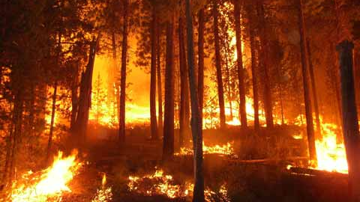
Forest fires
Ibm smart bridge project

Slide 2

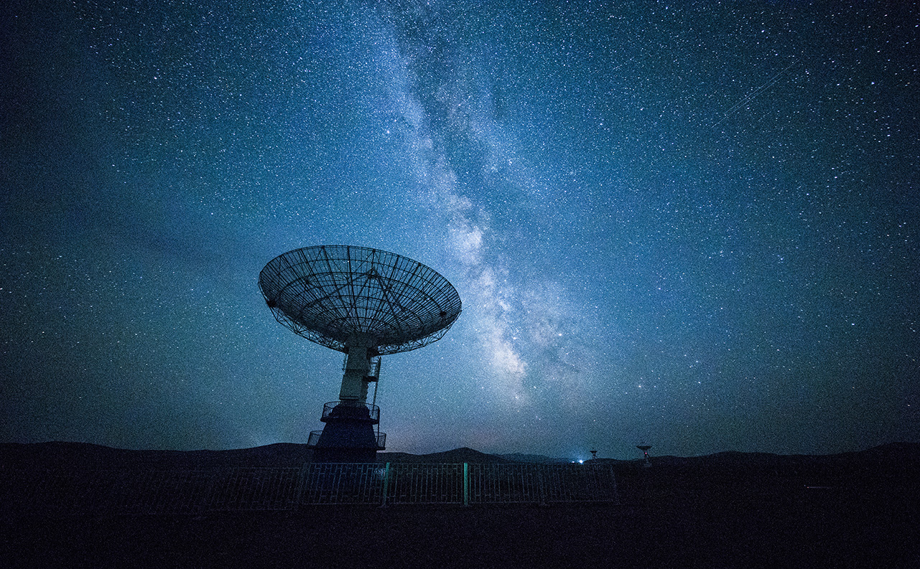
Team members
TEAM CAPTAN AMERICA
1] MANASWINI
2] TEJESH
3] SREEKAR
4] SINDHU
5] KARISHMA

Slide 3
INTRODUCTION
In India, about 55 per cent of the forest area, which is predominantly covered by deciduous forests, is prone to fires every year causing loss of about Rs. 440 crores (approximately 104 million dollars). It is estimated that proportion of forest areas, prone to forest fires annually ranges from 33 per cent in some of the states to over 90 per cent in other (FSI 1987). Despite the natural fires, the major sources of forest fires in India are anthropogenic, which include shifting cultivation practices, controlled burning, deforestation, fire wood burning and others.

Slide 4
ATTRIBUTE INFORMATION
X - x-axis spatial coordinate within the Montesinho park map: 1 to 9
Y - y-axis spatial coordinate within the Montesinho park map: 2 to 9
month - month of the year: "jan" to "dec"
day - day of the week: "mon" to "sun"
FFMC - FFMC index from the FWI system: 18.7 to 96.20
DMC - DMC index from the FWI system: 1.1 to 291.3
DC - DC index from the FWI system: 7.9 to 860.6
ISI - ISI index from the FWI system: 0.0 to 56.10
temp - temperature in Celsius degrees: 2.2 to 33.30
RH - relative humidity in %: 15.0 to 100
wind - wind speed in km/h: 0.40 to 9.40
rain - outside rain in mm/m2 : 0.0 to 6.4
area - the burned area of the forest (in ha): 0.00 to 1090.84 (this output variable is very skewed towards 0.0, thus it may make sense to model with the logarithm transform).

Slide 5
TECHNICAL DESCRIPTION
the output "area" was first transformed with a ln(x+1) function. Then, several Data Mining methods were applied. After fitting the models, the outputs were post-processed with the inverse of the ln(x+1) transform. Four different input setups were used. The experiments were conducted using a 10-fold (cross-validation) x 30 runs. Two regression metrics were measured: MAD and RMSE. A Gaussian support vector machine (SVM) fed with only 4 direct weather conditions (temp, RH, wind and rain) obtained the best MAD value: 12.71 +- 0.01 (mean and confidence interval within 95% using a t-student distribution). The best RMSE was attained by the naive mean predictor. An analysis to the regression error curve (REC) shows that the SVM model predicts more examples within a lower admitted error. In effect, the SVM model predicts better small fires, which are the majority.

Slide 6
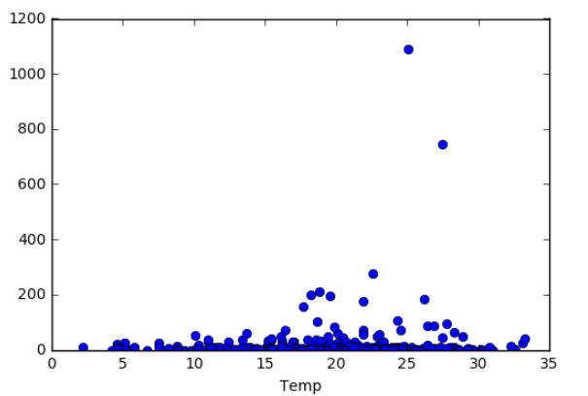
AREA VS TEMPERATURE

Slide 7

CONCLUSION AND OUTPUT:
An average of 5 million acres burns every year in the United States , causing millions of dollars in damage. Once a fire begins, it can spread at a rate of up to 14.29 miles per hour, consuming everything in its path. As a fire spreads over brush and trees, it may take on a life of its own -- finding ways to keep itself alive, even spawning smaller fires by throwing embers miles away. In this article, we will look at wildfires, exploring how they are born, live and die.
MODEL WTH MORE ACCURACY IS CONSIDERED AS GOOD MODEL
THE ACCURACY OF THIS MODEL PROJECT IS 76%

Slide 8

Thank You!
someone@example.com

